Slide 1
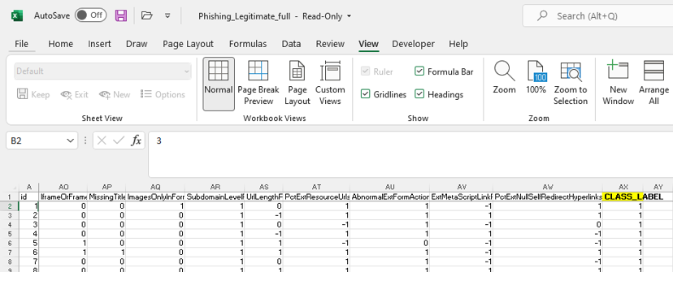
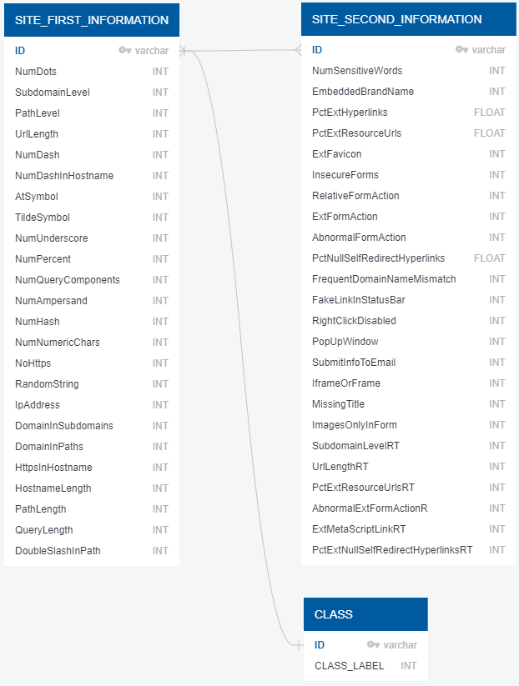
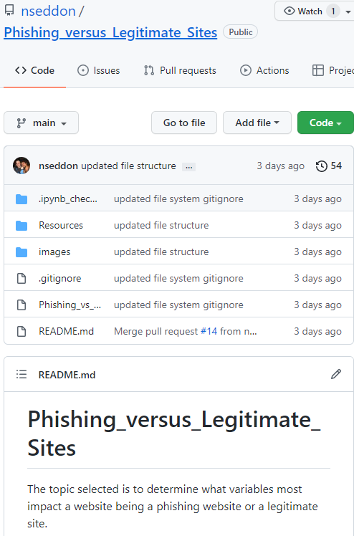
Dataset
Original database 50 features
The original data gets split in logical tables, features creating a connection with the ID
Gighub repository was created to upload our data and collaborate

Slide 2
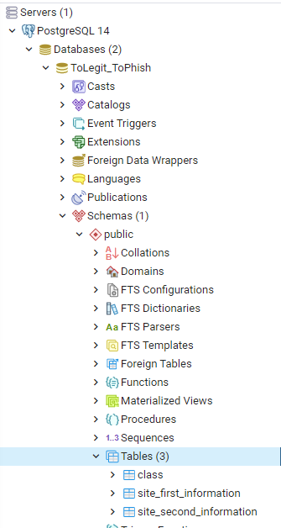
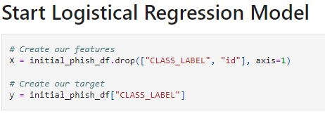
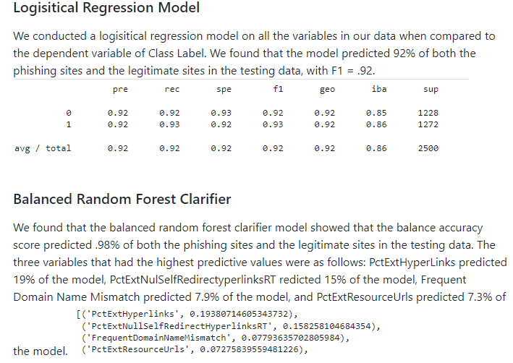
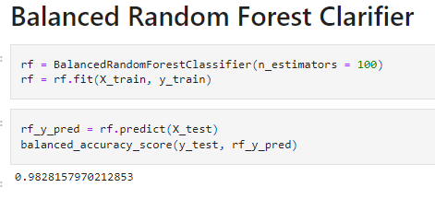
The tables were created in our SQL server and csv data uploaded. They were joined to create a final database to be used for our Machine Learning models
We used two machine learning models: Logistic Regression and Balanced Random Forest Classifier
Our results showed over 90% accuracy prediction. We were also able to identify the variables with the highest prediction values

